Slide 1

Title: Library System Management
Student Name: D.Venkata Mahith
Student ID: 2520030497
Cluster:03
Section: 12
Under the Guidance
of
Supervisor Name: Dr. Chaitanya Kumar
Assistant Professor
Department of CSE

Slide 2
OUTLINE
Abstract
Existing System
Proposed System
System Architecture
Project Modules
Objectives
Co’s Attainments - FWD
Co1
Co2 …….. 5. Co5
Co’s Attainments - DSA
Co1
Co2 …….. 5. Co5
Screen Shots for FWD & DSA
Conclusion
Geo-Tagged Photos

Slide 3
Abstract
Library Management System is a digital platform for managing library operations.
Designed to store, organize, and manage book records efficiently.
Allows librarians to add, update, delete, and search books easily.
Provides user access to check book availability.
Reduces manual paperwork and administrative effort.
Maintains accurate and centralized database of books and users.
Improves speed and reliability of library services.
Helps track issued books and return dates automatically.

Slide 4
Existing System
Libraries mostly use manual record keeping methods.
Book details are stored in registers or paper records.
Searching books manually takes more time.
Difficult to maintain large number of records.
High possibility of data duplication and mistakes.
Tracking issued books is complex and inefficient.
Manual systems lead to slow library operations.
Risk of data loss due to damage or misplacement.
Limited access to information for students.

Slide 5
Proposed System
Implement a web-based automated library management system.
Maintain digital records of books and members.
Allow librarians to manage books efficiently.
Provide quick search functionality.
Enable automatic tracking of issued and returned books.
Improve data accuracy and reduce human errors.
Provide secure access to authorized users.
Generate reports on book availability and transactions.
Improve overall library management efficiency.

Slide 6
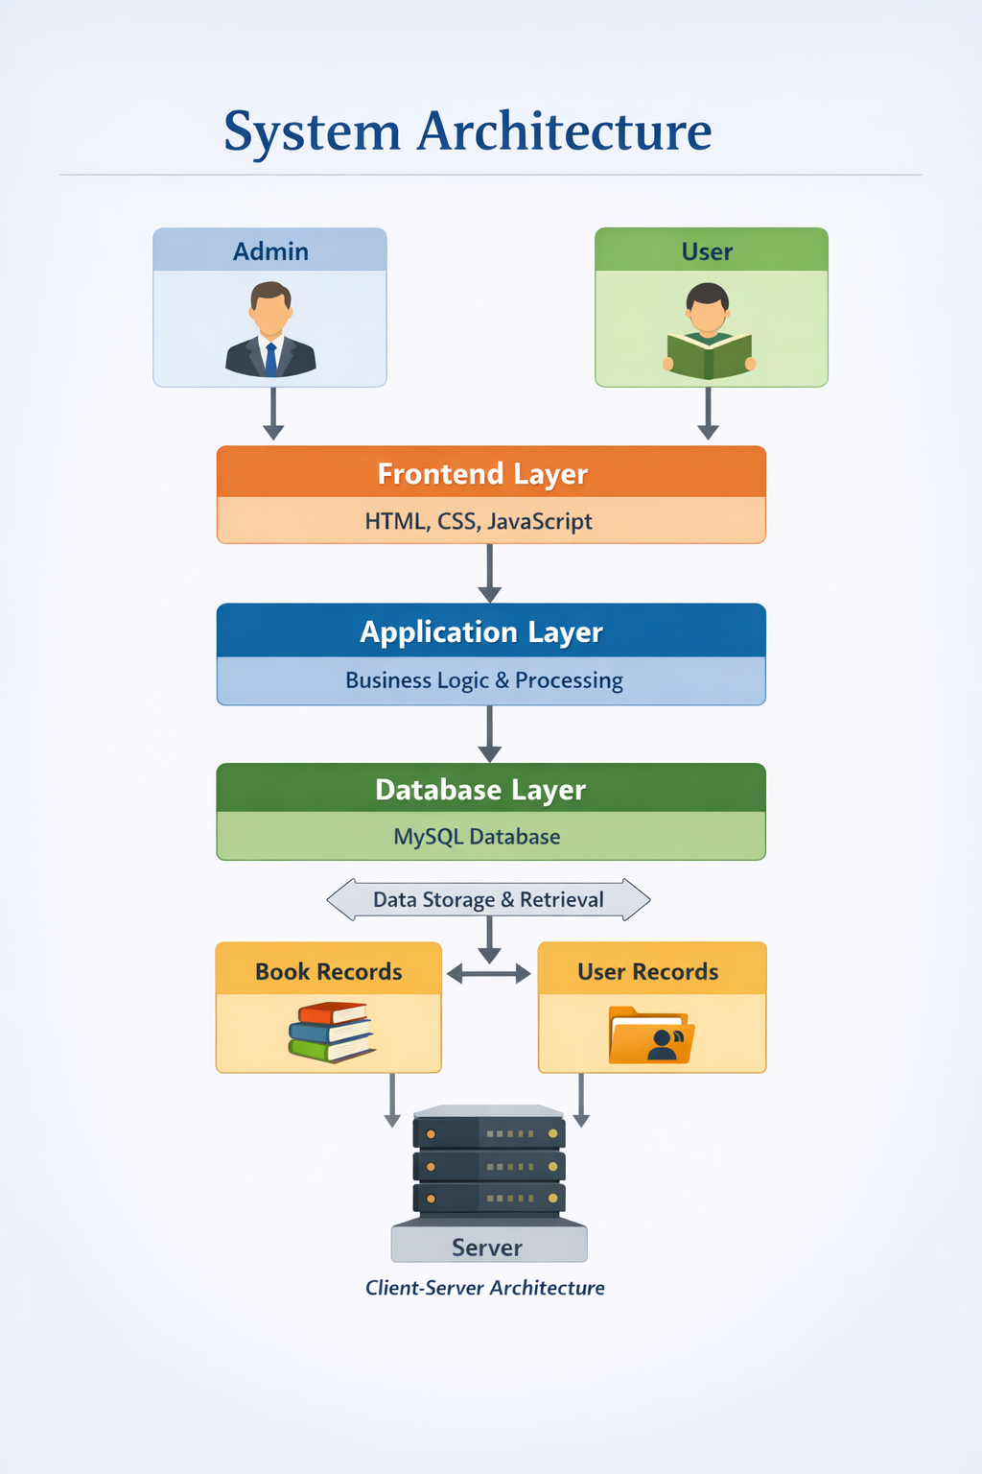
System Architecture

Slide 7
Project Modules
Admin Module
Add new books to the system
Update book information
Delete books from database
Manage user accounts
User Module
Search books by title, author, or category
Check book availability
View issued book details
Book Management Module
Maintain complete book database
Store book ID, title, author, category
Track available copies

Slide 8
Objectives
Develop an efficient library management system.
Reduce manual work in library operations.
Provide easy access to book information.
Improve data storage and management.
Enable fast searching of books.
Maintain accurate records of issued books.
Increase productivity of librarians.
Enhance user experience for students.

Slide 9
Co’s Attainments - DSA
CO1: Apply data structures for managing records.
CO2: Implement searching techniques for book retrieval.
CO3: Use arrays or lists to store book details.
CO3: Optimize data storage and retrieval operations.
CO4: Improve system performance using efficient algorithms.
CO4: Apply problem-solving skills in real-world applications.

Slide 10
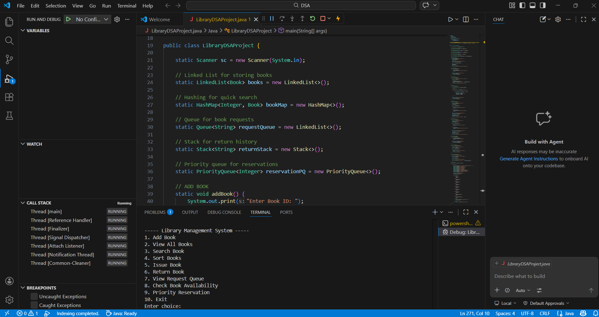
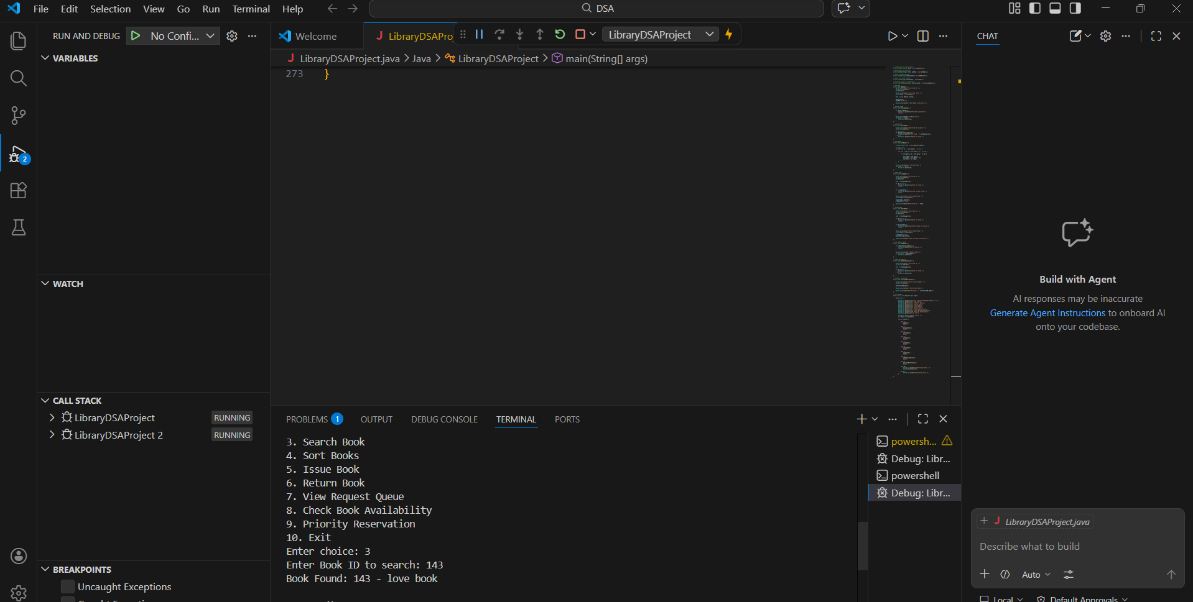
Screenshots for DSA

Slide 11
Conclusion
Library Management System improves efficiency of library operations.
Provides fast and accurate data management.
Eliminates manual paperwork.
Helps librarians manage books effectively.
Provides students easy access to book information.
Improves organization and maintenance of records.
Future improvements may include mobile app and barcode scanning.

Slide 12
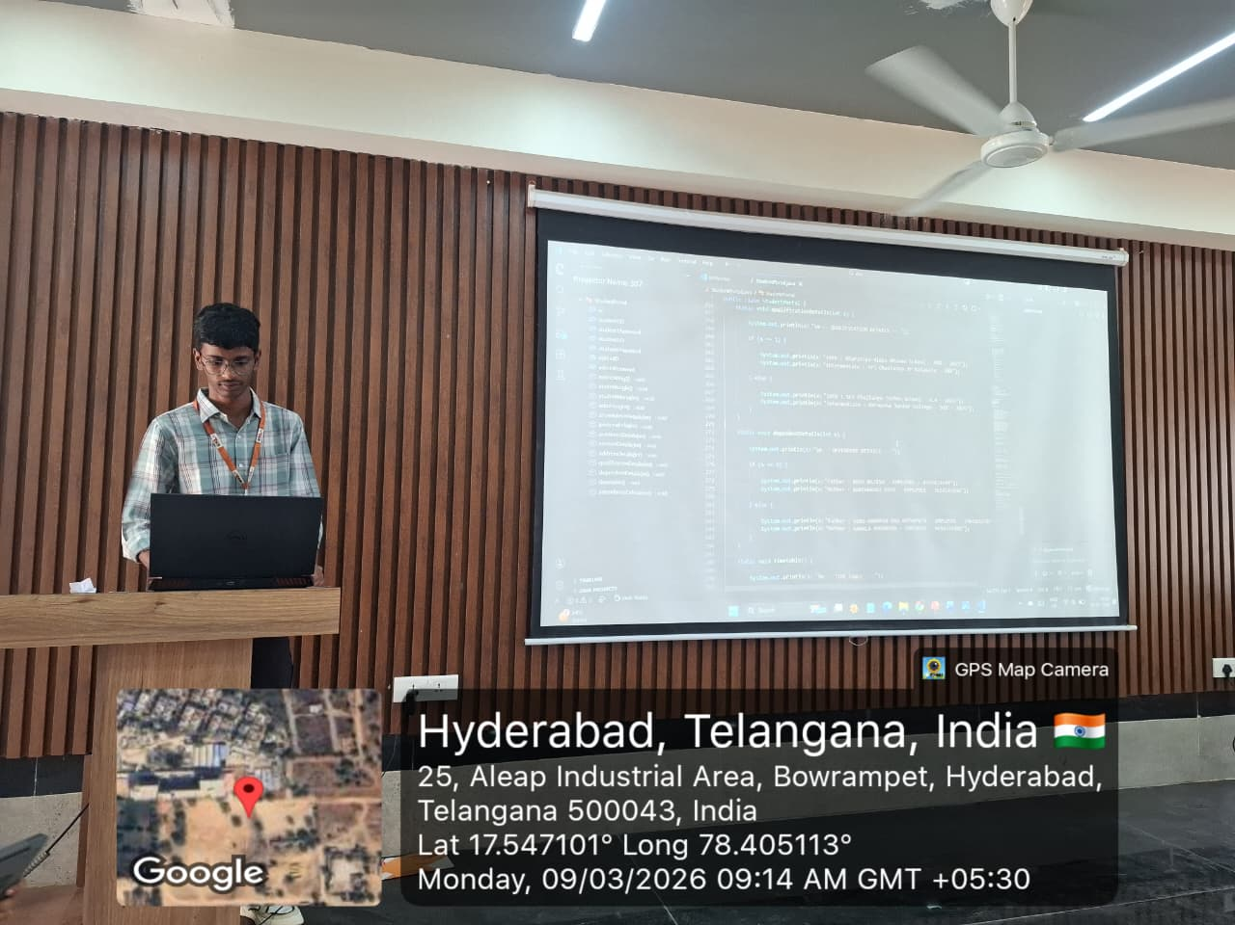
Geo- Tag Photos

Slide 13
THANK YOU

